Slide 1
Environmental, Social, and Governance (ESG) and you!
Can you invest in stocks based on their sustainability ratings?

Slide 2
Agenda
Overview
Database Framework
Deliverables
ESG intro
Target audience
Our Journey
Our questions
Proposed solution
Team
Project objective
Data Exploration

Slide 3

Overview
Here at ESG Consulting, we are building a machine learning module to:
Help you invest in ESG.
Determine if ESG scores effect investor’s confidence.
Notes:
Deliverable: Selected topic
Presenter: Sachin
Speaker Notes:

Slide 4
What is ESG &
Why is it Important?
Notes:
Time check: 30 seconds
Deliverable: Selected topic
Presenter: Sachin
Speaker Notes:

Slide 5

What is ESG?
Set of standards used to measure a company’s adherence to environmental, social and corporate governance standards.
Notes:
Deliverable: Reason the topic is selected
Presenter: Sachin
Speaker Notes:

Slide 6



Why is ESG Important?
Social
Governance
Environment
E
Health & Safety
Human Rights
G
S
Natural resources
Climate risk
Ethical standards
Shareholder rights
Notes:
Deliverable: Reason the topic is selected
Presenter: Sachin
Speaker Notes: Environment (E): 56% of population lives in cities and towns and account for 70% of CO₂ emissions by 2050 70% will live in towns and cities. The global temperature will rise by 1.5◦ C if we have Net Zero Emissions of CO₂ by 2050 otherwise may be more than 3.5◦ C.
We want to know whether about the company’s energy use , waste, pollution, natural resource conservation, treatment of animals etc.
Social (S): The global population is 8 billion set to rise to 8.5 billion by 2030 and 9.7 billion by 2050. Community Relations and Human Rights, Workplace Health and Safety, Diversity and Inclusion cannot be overlooked.
We want to know company’s does a company donate a portion to local communities , and all points mentioned above in grey.
Governance(G): With a population of more than 8.5 billion and global temperatures rising the need for innovation in Policy and Code of Conduct, Supply Chain Management, CSR initiatives is a must for any company.
Company uses accurate and transparent accounting methods, stockholder’s allowed to vote on important issues and all mentioned in grey above.

Slide 7
What do we hope to answer?
Is there a correlation between stock performance and ESG ratings?
Have companies adapted better to ESG based on industry?
1
3
2
How does ESG scores affect a company’s bottom line?
4
What are the red flags that affect ESG ratings?
Notes:
Time check: 1.20
Deliverable: Questions the team hopes to answer with the data
Presenter: Sachin
Speaker Notes:

Slide 8
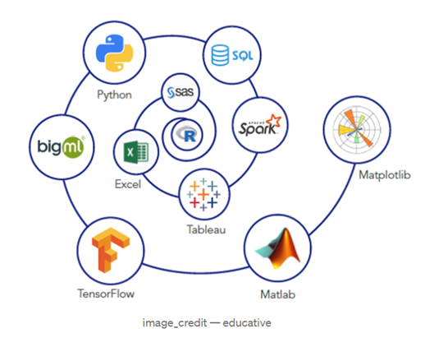
Tools Used
01 | Python
02 | APIs
03 | AWS, Postgres, SQLAlchemy
03 | FBProphet & SKLearn
03 | Tableau
Notes:
Deliverable: Description of the source of data
Presenter: Sachin
Speaker notes:
Python and libraries like pandas, numpy, plotly, seaborn for EDA.
Finance API’s like yfinance and yesg for data extraction.
fbprophet and sklearn for machine learning
AWS RDS Postgres, sqlalchemy for database connection
Tableau for visualization

Slide 9


The Data Source
The Just 100 (Forbes)
ESG ratings
Yahaoo! Finance
Historical stock data
Notes:
Time check: 1:40
Deliverable: Description of the source of data
Presenter: Sachin
Speaker Notes:
Forbes:
Sustainability parameters like environment, social, even public sentiment for various companies which have been rated highly based on their ESG initiatives.
Performance metrics like RoE, RoA, revenue
Yahoo!
Five years of historical stock price data to predict the stock prices using machine learning.

Slide 10
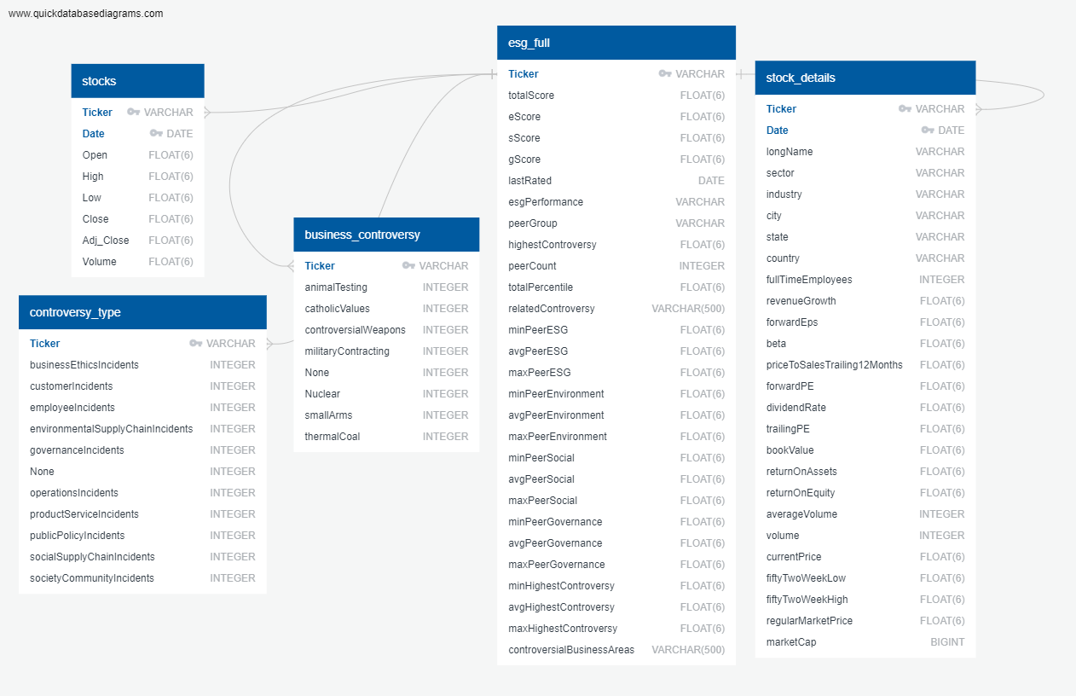
Database
Framework
Update ERD Diagram
Notes:
Time check: 2:05
Deliverable: Description of the data exploration phase of the project
Speaker Notes:
Our Database contains:
stocks
controversy_type
business_controversy
esg_full
stock_details

Slide 11

The Analysis
Data Exploration
ETL Pipeline
Results
ESG scores
Reg Flags
Stock Analysis
Notes:
Time check:
Deliverable: Result of the analysis
Presenter: Sucharita
Speaker Notes:

Slide 12



Data Exploration
Feature Engineering
Training & Test Sets
Data Preprocessing
01
03
02
Notes:
Time check: 2:30
Deliverable: Description of the data exploration phase of the project
Presenter: Sucharita
Speaker Notes:
Data Preprocessing:
Remove duplicate/null data.
Break data into smaller tables
Remove noisy data
Feature Engineering
Identify features for optimal performance.
Ensure proper encoders
Training & Test Sets
Use test_train_split from sklearn to split data.
Scale data accordingly

Slide 13
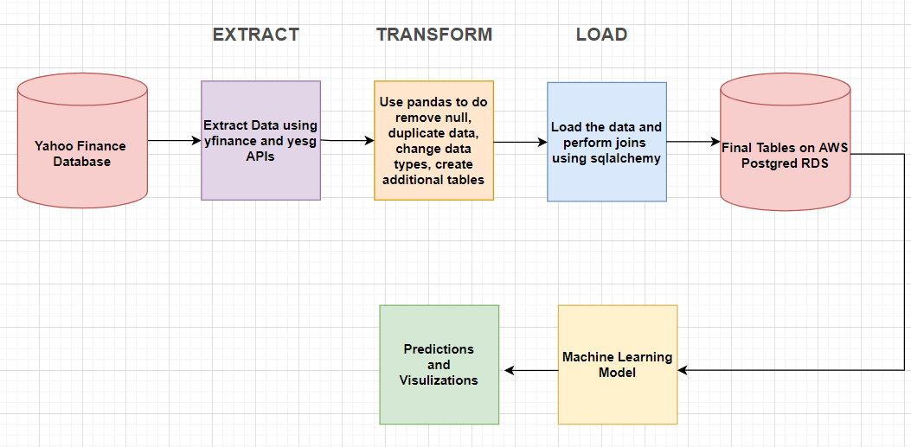
ETL Pipeline
Notes:
Deliverable: Description of the data exploration phase of the project
Presenter: Sucharita
Speaker Notes:

Slide 14
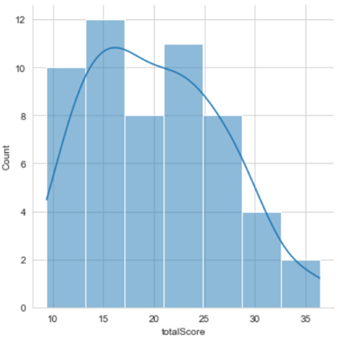
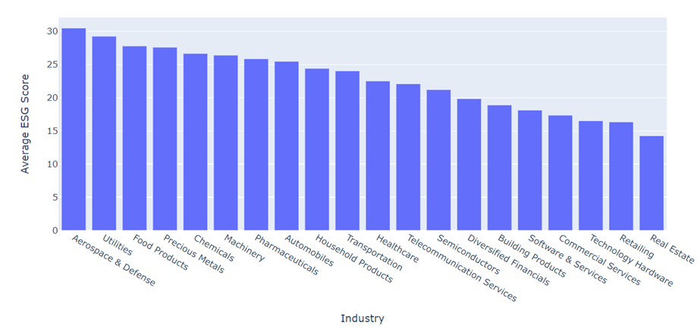
ESG Scores Distribution
Notes:
Time check: 2:40
Deliverable: Result of the analysis
Presenter: Sucharita
Speaker Notes:

Slide 15
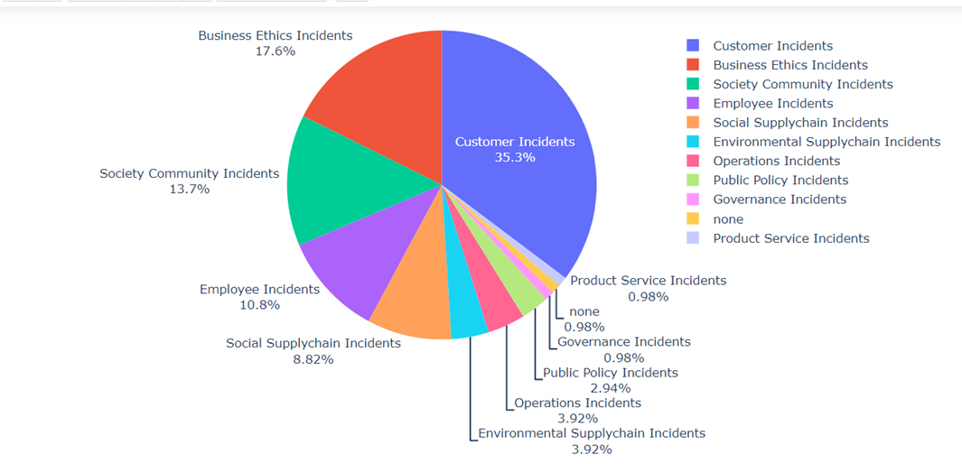
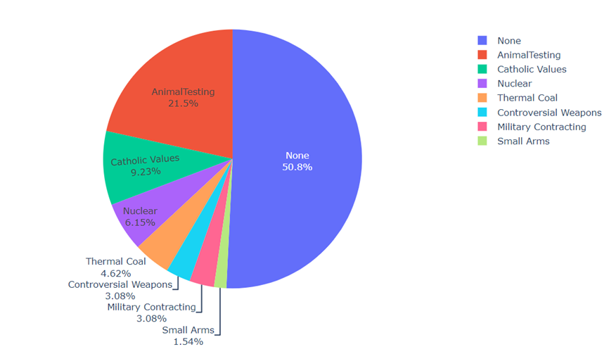
Red Flag Analysis
Notes:
Time check:
Deliverable: Result of the analysis
Presenter: Sucharita
Speaker Notes:

Slide 16
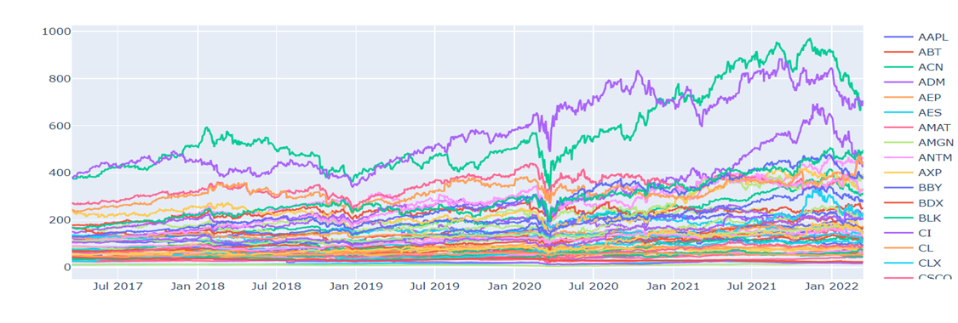
Stock Prices
Notes:
Time check:
Deliverable: Result of the analysis
Presenter: Sucharita
Speaker Notes:

Slide 17
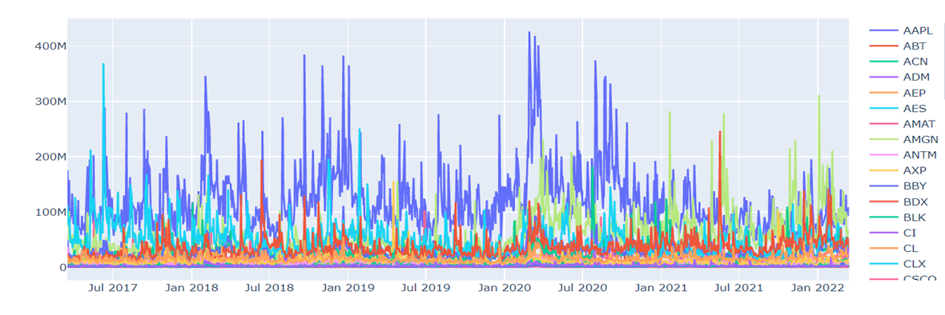
Stock Volumes
Notes:
Time check:
Deliverable: Result of the analysis
Presenter: Sucharita
Speaker Notes:

Slide 18
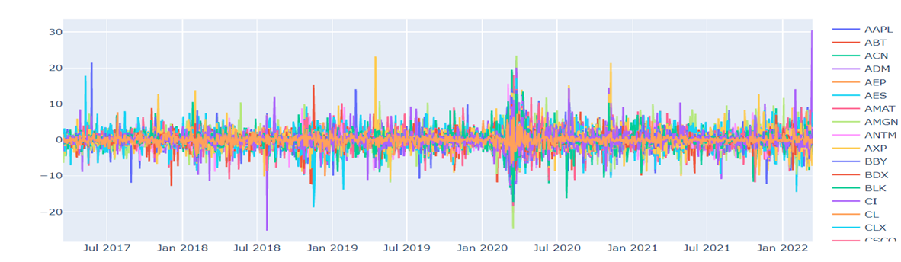
Daily Stock Returns
Notes:
Time check:
Deliverable: Result of the analysis
Presenter: Sucharita
Speaker Notes:

Slide 19

Machine Learning
Stock Predictions
Investor Confidence
Notes:
Time check: 3:30
Deliverable: Result of the analysis
Presenter: Yicong
Speaker Notes:

Slide 20
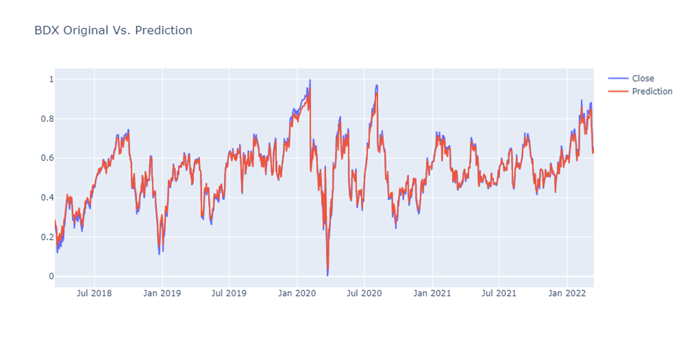
Machine Learning for Stock Predictions
Notes:
Deliverable: Description of the analysis phase of the project
Deliverable: Technologies, languages, tools, and algorithms used throughout the project
Presenter: Yicong
Speaker Notes: Our first model was linear regression which could not predict stocks beyond a few days due to trends and non-linearity, so finally fbprophet was chosen
Benefits:
It does not require much prior knowledge of forecasting time series data
Based on an additive model where non-linear trends are fit with yearly, weekly, and daily seasonality, plus holiday effects.
Prophet is robust to missing data and shifts in the trend, and typically handles outliers well.
Limitations:
Prophet is generally recommended only for time series where the only informative signals are trends, and the residuals are just noise.
There are other models like ARIMA can consistently outperform Prophet when trends are not too important.

Slide 21
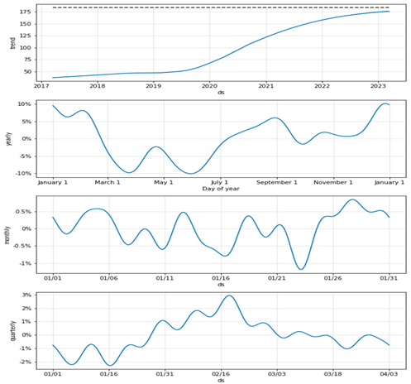
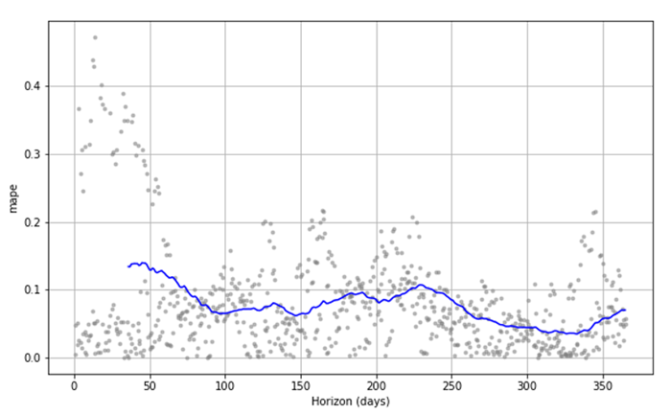
Example: Apple
Mean absolute percentage error (MAPE) & Forecast for Apple stock
Notes:
Time check: 4:10
Deliverable: Description of the analysis phase of the project
Deliverable: Technologies, languages, tools, and algorithms used throughout the project
Presenter: Yicong
Speaker notes:

Slide 22
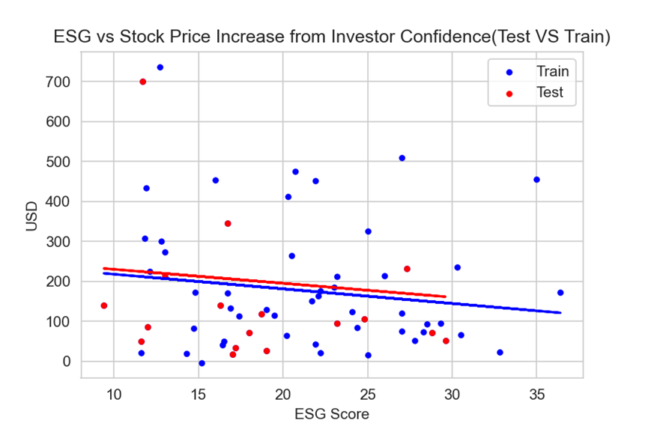
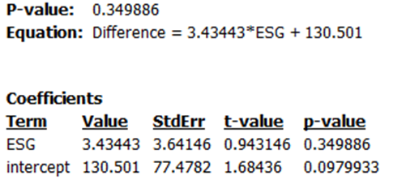
Machine Learning For ESG vs Stock Price
Notes:
Time check: 4:30
Deliverable: Description of the analysis phase of the project
Deliverable: Technologies, languages, tools, and algorithms used throughout the project
Presenter: Yicong
Speaker Notes:
Our linear regression model compares ESG to stock prices
●Benefits:
All the companies can use this method because sales are always positive. In the dividend method, if the current year dividend is Zero, we cannot use it.
No human intervention is needed (automation)
It shows a positive relationship between the value of Stock Price increase from investor confidence and ESG Score.
●Limitations:
This method is for comparable companies(industry). We need to make sure all the companies in the same industry must have a similar size. ex: Sobey and Walmart are supermarkets, but one is national, and another is global
The p-value is 0.34, which is higher than 0.05. We cannot use this model to measure how many prices of ESG influences the stock price, but it shows us ESG has a positive relationship with the stock price.
Our model only uses 2022 information, which can show you a short-term relationship. If we can add past year information, it will establish an exact relationship.
Improvements: More Data, Increasing Scope and Time. In this model, we use 89 companies, that are not enough, and we only get the 2022 ESG score because the old information is not for the public.

Slide 23

The Dashboard
Why Tableau?
DB Integration
Simple & Clean
Interactive
Notes:
Time check: 5:40
Deliverable: Result of the analysis
Presenter: Monica
Speaker Notes:
Tableau offers integration with our database increasing longevity and reusability
Tableau provides clean and easy ways to visualize our data
Storyboards allow our users to interact with our dashboard to drill down and learn more

Slide 24
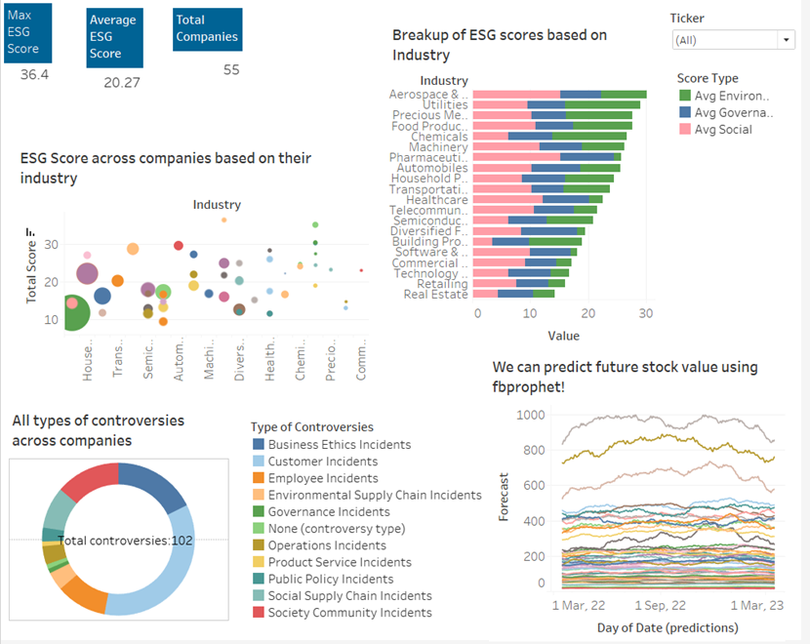
Interactive Demo
Switch to Demo
Notes:
Time check:
Deliverable: Demo of interactive dashboard
Presenter: Monica
Call out: if Demo doesn’t work - continue via next 5 slides
Speaker Notes:
Our interactive dashboard highlights the following areas:
ESG score vs RoE (bubble)
ESG score by industry (bar)
Red flags (# of incidents) by type
Stock performance over time

Slide 25
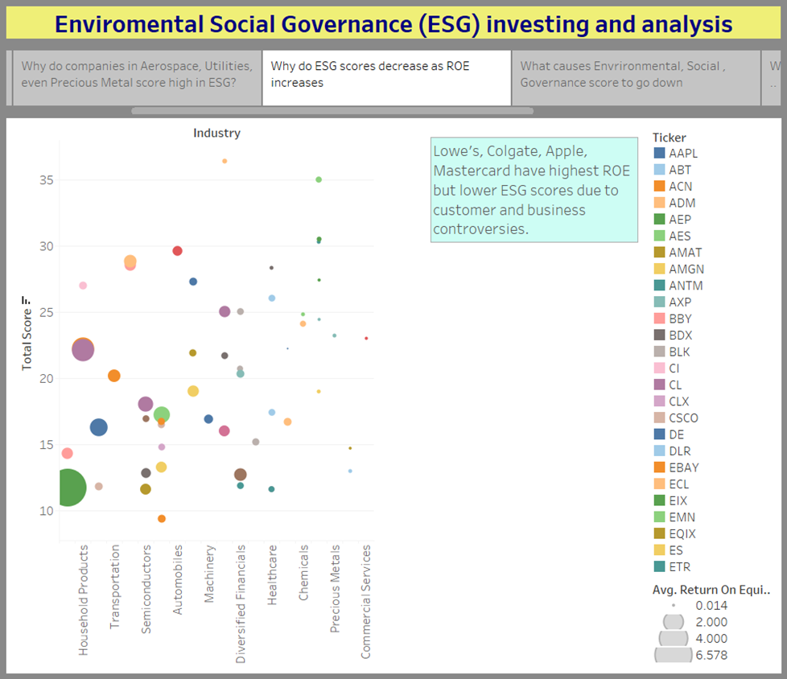
ESG Score vs RoE
Our Industry analysis concludes the following:
There is a negative correlation with RoE and ESG score
The retail industry has a high RoE, but very low ESG scores
Notes:
Deliverable: Demo of interactive dashboard
Presenter: Monica
Call out: if Demo doesn’t work - continue via next 5 slides
Speaker Notes: see demo

Slide 26
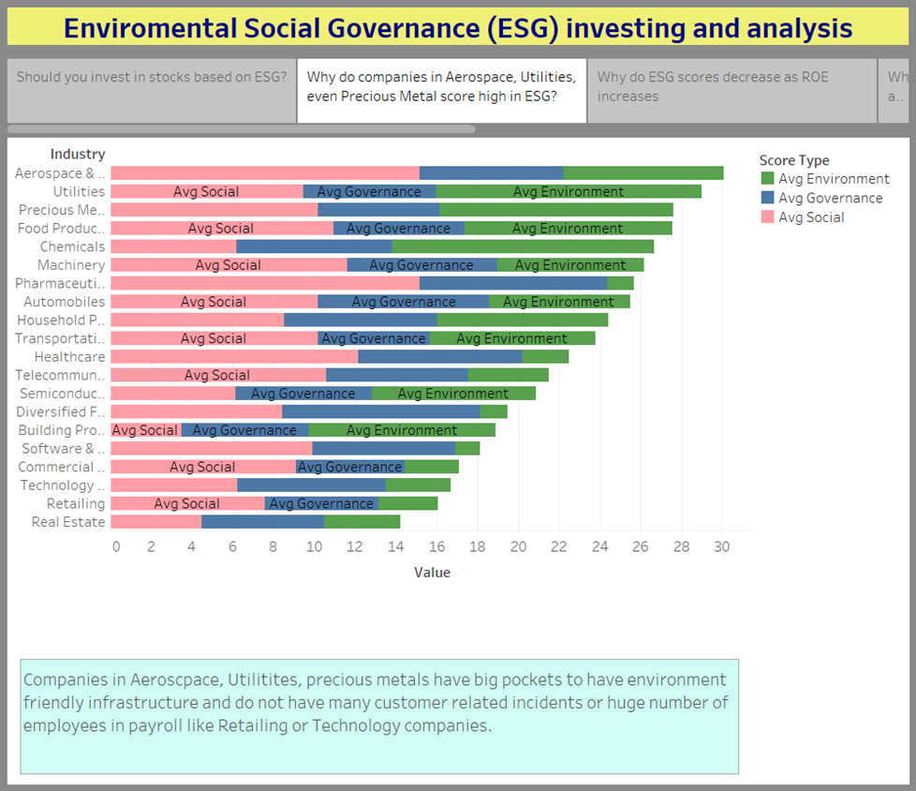
ESG score by Industry
Reviewing ESG scores by industry we can determine the following:
Utility companies have the best scores
Machinery, Insurance, Building products have low scores
Notes:
Deliverable: Demo of interactive dashboard
Presenter: Monica
Call out: if Demo doesn’t work - continue via next 5 slides
Speaker Notes: see demo

Slide 27
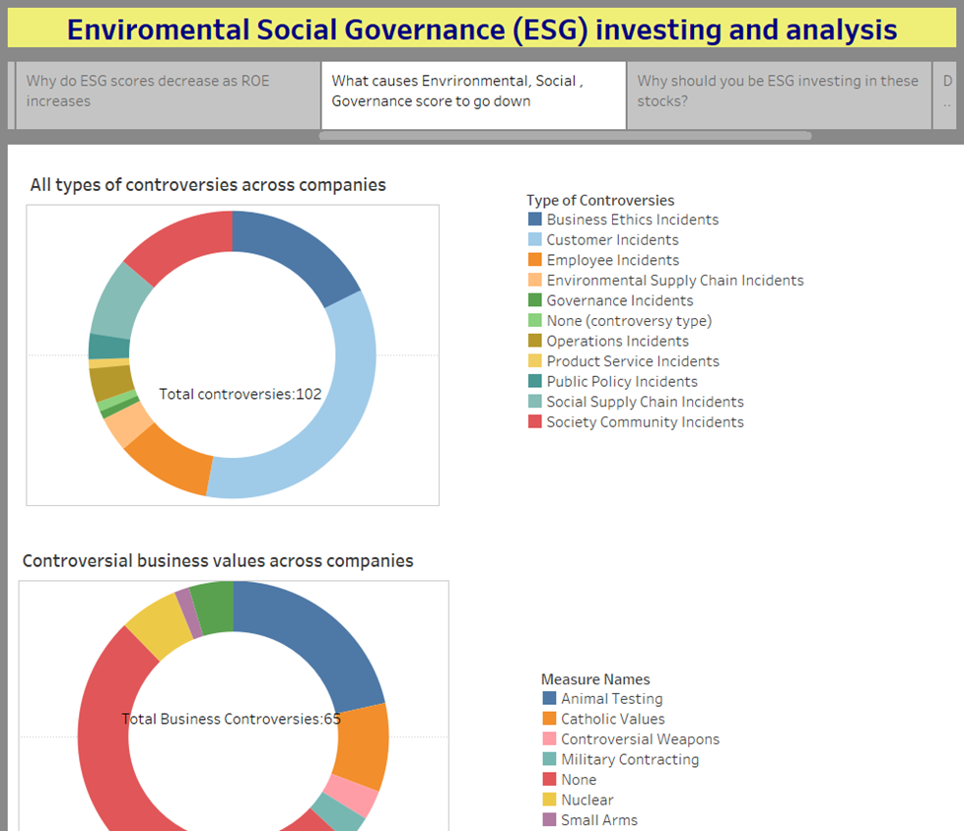
Controversy Indicators
Controversial behaviour have a negative impact on ESG scores
Business Ethics and Customer Incidents are more common types of incidents
Notes:
Deliverable: Demo of interactive dashboard
Presenter: Monica
Call out: if Demo doesn’t work - continue via next 5 slides
Speaker Notes: see demo

Slide 28
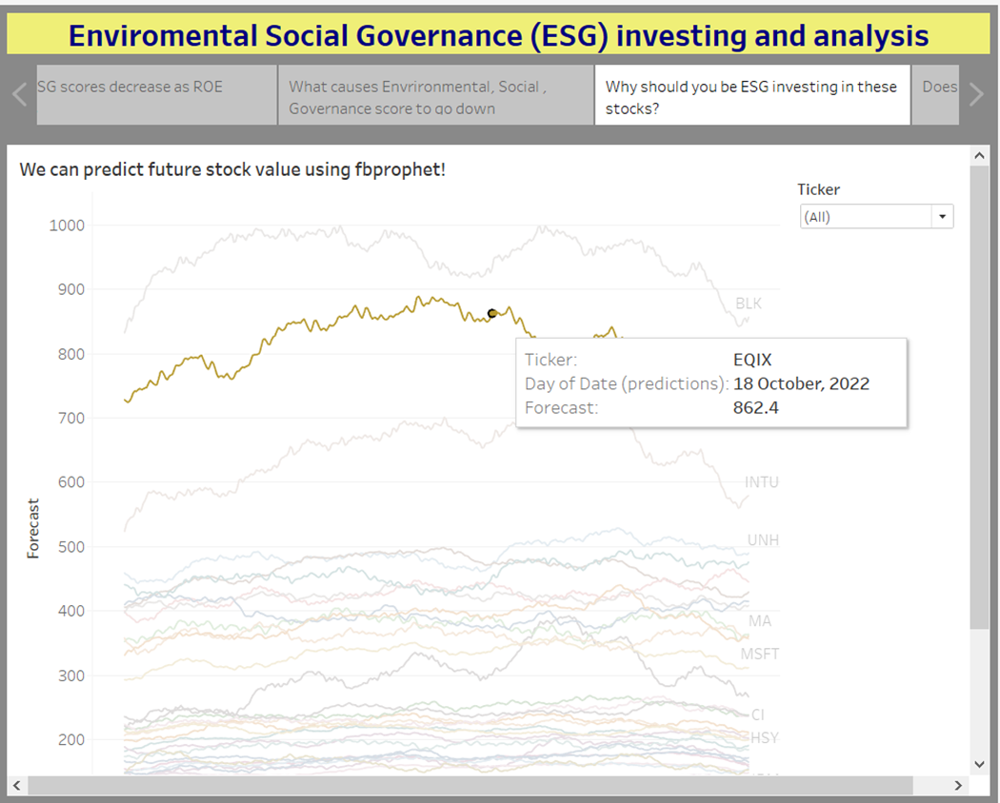
Stock Performance
Reviewing the stock performance, we can determine the following:
Performance is up as a whole
Notes:
Deliverable: Demo of interactive dashboard
Presenter: Monica
Call out: if Demo doesn’t work - continue via next 5 slides
Speaker Notes: see demo

Slide 29
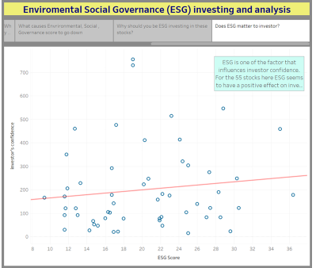
Stock Performance
Reviewing the stock performance, we can determine the following:
Performance is up as a whole
Notes:
Deliverable: Demo of interactive dashboard
Presenter: Monica
Call out: if Demo doesn’t work - continue via next 5 slides
Speaker Notes: see demo

Slide 30
Summary & Next Steps
Our Team
Our Journey
Our Sources
Our Q&A
Notes:
Time check: 7:40
Deliverable: Recommendation for future analysis
Presenter: Monica
Speaker Notes:

Slide 31

Our Team
Sachin Nabar: Database Administrator
Sucharita Bhattacharjee: Lead Analysis
Yicong (David) Luo: Machine Learning Specialist
Monica Dodds: Visualization
Notes:
Time check:
Deliverable: Recommendation for future analysis
Presenter: Monica
Speaker Notes:
Note: Imaginary titles are based on roles taken during our presentation.
Teamwork went into every step of process so all members could contribute to all aspects of the project.

Slide 32
Our Journey
Week 1
Week 3
Future Goals
Week 2
Weeks 4 & 5
Gather data
Initialize DB & ML models
Finalize DB integration
Finalize ML models
Draft dashboard & presentation
Reduce MAPE
Explore other models
Perform periodic DB refreshes
3/20/22
4/14/22
3/15/22
3/27/22
TBD
Finalize data
Establish Database Connectivity
Begin Machine Learning
Finalize ML models
Integrate ML & DB into Dashboard
Notes:
Time check:
Deliverable: Recommendation for future analysis
Presenter: Monica
Speaker Notes:
Deliverable: Recommendation for future analysis
To reduce MAPE on predictions using hyperparameter tuning on each stock.
To checkout ARIMA. LSTM Models for better performance
To update the tables periodically in future as data changes and have a database of historical ESG data.

Slide 33
References
https://www.investopedia.com/terms/e/environmental-social-and-governance-esg-criteria.asp
https://ca.finance.yahoo.com/
https://www.forbes.com/just-companies/#5d410d762bf0
https://en.wikipedia.org/wiki/List_of_S%26P_500_companies
https://en.wikipedia.org/wiki/Environmental,_social_and_corporate_governance
https://ecyy.medium.com/forecasting-by-fb-prophet-in-colab-c9d4db2d4195
https://www.analyticsvidhya.com/blog/2021/07/stock-prices-analysis-with-python/
https://www.alva-group.com/blog/what-is-an-esg-score-and-how-is-it-calculated/
Notes:
Time check:
Deliverable: Recommendation for future analysis
Presenter: Monica
Speaker Notes:

Slide 34
Thank you!
Q & A

